Slide 2

AIRLINE DATABASE MANAGEMENT SYSTEM
J Component Review 1
ITE1003 – DATABASE MANAGEMENT SYSTEM
SLOT – A2
PROFESSOR: PRABHAVATHY P

Slide 3
GROUP MEMBERS:
Name | Registration Number
Shivam Chawla | 15BIT0336
Vaibav Bhat | 15BIT0287
Vinnay | 15BIT0165

Slide 4
AIRLINE DATABASE MANAGEMENT SYSTEM
Our Airline Database System which consists of Flights, Flight schedule, Fare, Airport, Passenger reservation, employee management, Ticket entities aims to create a database management system so as to make and airline enquiry/booking system more efficient and easy to manage.

Slide 5
Entity list
AirCrafts
Route
AirFare
Flight Schedule
Discounts
Charges
Countries
State
Contact Details
Passengers
Branches
Employee
Transactions

Slide 6
Entity Description
AirCrafts
Route
Field | DataType | Description | Constraints
AcID | INT | Field will store unique row number. | Primary Key
AcNumber | Varchar(32) | Aircraft number that identifies the plane. | NOT ULL
Capacity | INT | No. of seats available. | NOT NULL
MfdBy | Varchar(128) | Manufacturing company. | NOT NULL
MfdOn | DATETIME | Manufactured date of aircraft. | NOT NULL
Field | Data Type | Description | Constraints
RtID | INT | Stores unique row id. | Primary Key
Airport | Varchar(32) | From where the flight will take off. | NOT NULL
Destination | Varchar (32) | Flight destinations. | NOT NULL
RouteCode | Varchar(16) | A unique Route code generated using Source & Destination of flight. | NOT NULL UNIQUE

Slide 7
Entity Description
AirFare
Flight_Schedule
Field | Data Type | Description | Constraints
AfID | INT | Stores unique row id. | Primary Key
Route | INT | Route id from Route table. | Foreign Key
Fare | Currency | Stores service charge amount. | NOT NULL
FSC | Currency | Stores fuel surcharge amount. | NOT NULL
Field | Data Type | Description | Constraints
FlID | INT | Unique number to identify the flight. | Primary Key
FlightDate | DATETIME | Date of flight. | NOT NULL
Departure | DATETIME | Stores the departure time of flight.
Arrival | DATETIME | Stores the arrival time of flight on destination.
AirCraft | INT | Aircraft number that will fly, a number from Aircraft table. | Foreign Key
NetFare | INT | To determine total fare of flight, an ID from Air_Fare table. | Foreign Key
Discounts
Field | Data Type | Description | Constraints
DiID | INT | Unique row id. | Primary Key
Title | Varchar(32) | Label to know discount. | NOT NULL
Amount | INT | Discount amount in % | NOT NULL
Description | Varchar(255) | Discount remarks & details.

Slide 8
Entity Description
Charges
Contact_Details
Field | Data Type | Description | Constraints
ChID | INT | Unique row id. | Primary Key
Title | Varchar(32) | Label for charge. | NOT NULL
Amount | INT | Amount of charge in %. | NOT NULL
Description | Varchar(255) | Describe cause of charge.
Field | Data Type | Description | Constraints
CnID | INT | Unique row id. | Primary Key
Email | Varchar(16) | Passenger’s contact email for transaction about flights. | NOT NULL
Cell | Varchar(16) | Passenger’s contact cell no for transaction about flights. | NOT NULL
Tel | Varchar(16) | Passenger’s contact telephone no. for transaction about flights.
Street | Varchar(64) | Street address of the passengers. | NOT NULL
State | INT | PK from State table. | Foreign Key
Countries
Field | Data Type | Description | Constraints
CtID | INT | Unique row id. | Primary Key
CountryName | Varchar(32) | Room to store country name | NOT NULL
State
Field | Data Type | Description | Constraints
StID | INT | Unique row id. | Primary Key
StateName | Varchar(32) | State name will take place here.
Country | INT | PK from Country table. | Foreign Key

Slide 9
Entity Description
Passengers
Employees
Field | Data Type | Description | Constraints
PsID | INT | Unique row id. | Primary Key
Name | Varchar(32) | Passenger’s name | NOT NULL
Address | Varchar (64) | Passenger’s address | NOT NULL
Age | INT | Passenger’s age | NOT NULL
Nationalities | Varchar (16) | Nationality of the passenger. | NOT NULL
Contacts | INT | ContactID from Contact_Details table. | Foreign Key
Field | Data Type | Description | Constraints
EmpID | INT | Unique number to identity employee, unique on entire system. | Primary Key
Name | Varchar(32) | Employee name | NOT NULL
Address | Varchar(32) | Employee address | NOT NULL
Branch | INT | Associated branch id from Branch Table | Foreign Key
Designation | Varchar(32) | Working duty position. | NOT NULL
Email | Varchar(32) | Contact email of the employee | NOT NULL
Tel | Varchar(16) | Contact telephone number.
Ext | INT | Ext number of employee cabinet, if applicable.
Branches
Field | Data Type | Description | Constraints
BrID | INT | Unique id for each branches | Primary Key
Center | Varchar(16) | Branch Title | NOT NULL
Address | Varchar(32) | Address of the branch | NOT NULL
State | INT | State ID from state table | Foreign Key

Slide 10
Entity Description
Transactions
Field | Data Type | Description | Constraints
TsID | INT | Unique row id | Primary Key
BookingDate | Date/Time | Keeps the booking date. | NOT NULL
DepartureDate | Date/Time | Keeps the departure date. | NOT NULL
Passenger | INT | Transaction creator passengers row id to associate booking/cancellation, payments etc. | Foreign Key
Flight | INT | Flight no, a PK of Flight_Schedule to determine flying details & costs. | Foreign Key
Type | BIT | Reservation/Cancellation | NOT NULL
Employee | INT | Reservation agent, a row id of employee who helps the passenger to make transaction. | Foreign Key
Charges | INT | If transaction is cancellation, charges may apply as per business rules. | Foreign Key
Discount | INT | Discount offers may apply based on scheme criteria. | Foreign Key
Total | INT | Calculated value of actual payable cost by customer to make a transaction. | NOT NULL

Slide 11
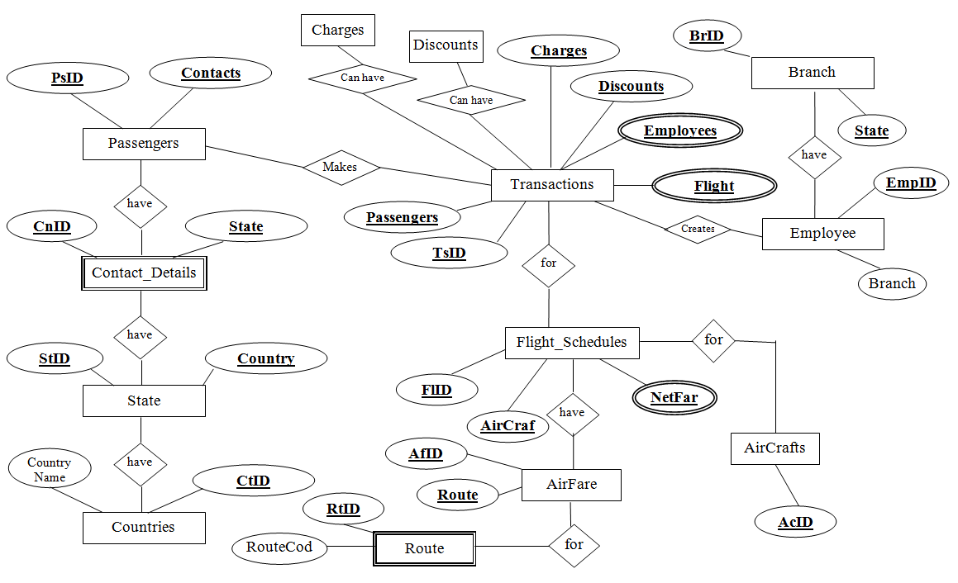
ER Diagram:

Slide 12
CARDINALITY RATIO
SN | Entities | Cardinality
1. | AirCrafts & Flight_Schedule | 1 : M
2. | Route & AirFare | 1 : 1
3. | AirFare & Flight_Schedule | 1 ; M
4. | Discounts & Transactions | N : 1
5. | Charges & Transactions | N : 1
6. | Countries & State | 1 : M
7. | State & Branches | 1 : M
8. | Contact_Details & State | M : 1
9. | Passengers & Contact_Details | 1 : 1
10 | Passengers & Transactions | 1 : 1
11. | Branches & Employee | 1 : M
12. | Employees & Transactions | 1 : M
13. | Transactions & Flight_Schedule | M : 1

Slide 13
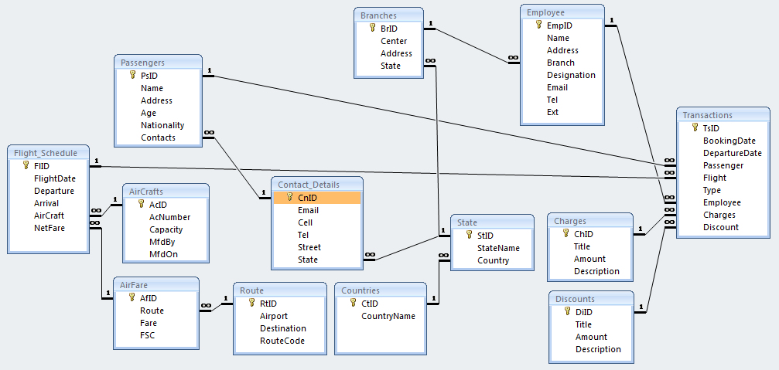
ER to Relational Mapping

